Slide 1

Mini Project-I (K24MCA18P) Odd Semester Session 2024-25
Grab Bus
Team Leader: Priyanshu Kansal and University Roll Number: 2426mca333
Member Names: Prabhav Kansal and University Roll Number: 2426mca331
Member Names: Sagar Gupta and University Roll Number: 2426mca336
Project Supervisor:
Supervisor Name
Designation

Slide 2
Content
Introduction (1 slide)
Literature Review (2 slides)
Objective of the Project (1 slide)
Technology
Hardware Requirements (Development Environment, Server requirement (if required), Client requirement (if required).
Software Requirements (Language and Platforms like Frameworks, VS code, Android Studio and Jupyter notebook etc. )
Modules (2-3 slides)
Notes:
Font Styles: Times New Roman + Font Size: 25

Slide 3
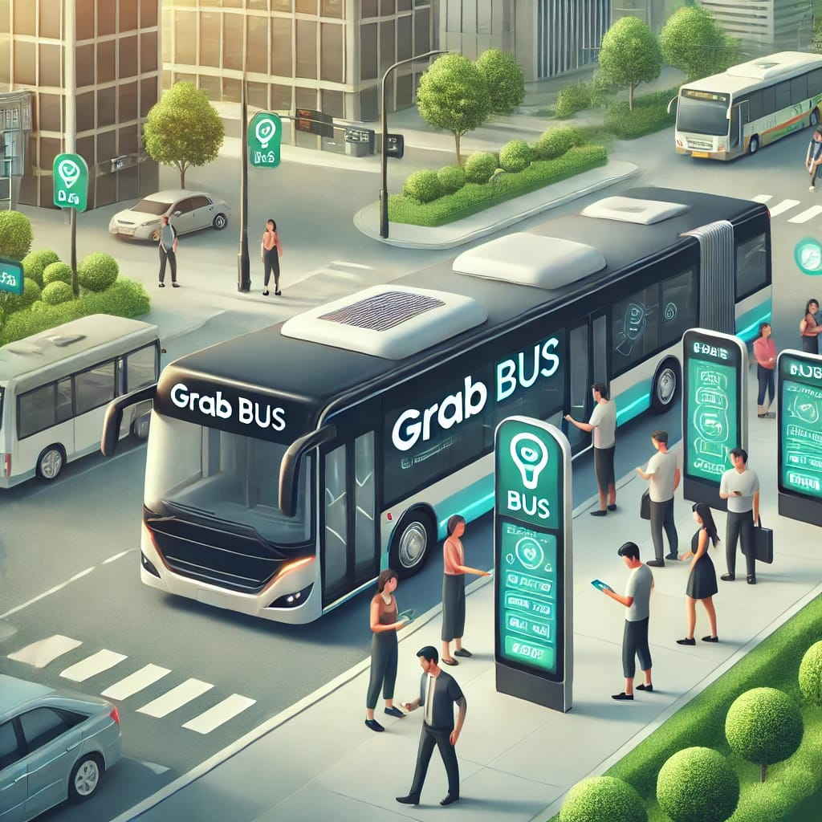
Introduction
Introduction to Grab Bus
Welcome to our presentation on Grab Bus, The Grab Bus Project is an innovative initiative aimed at revolutionizing public transportation by leveraging technology to improve efficiency, accessibility, and convenience for commuters. As urban areas grow and traffic congestion becomes a major challenge, the need for smarter and more reliable transportation solutions has never been greater. Grab Bus aims to fill this gap by offering a seamless, user-friendly platform that integrates real-time tracking, digital ticketing, and optimized bus routes. This project not only enhances the commuter experience but also contributes to sustainable urban mobility by encouraging the use of public transport over private vehicles.The Grab Bus Project seeks to modernize the bus transit system, making it more appealing, efficient, and eco-friendly for daily travelers.
.
Notes:
Font Styles: Times New Roman + Font Size: 25

Slide 4
Literature Review
Overview of Grab Bus Literature
Optimize Routes and Timings:
Using real-time data and predictive algorithms to ensure buses operate efficiently, reducing wait times and
overcrowding.
Improve Accessibility:
Enhancing rural connectivity by identifying underserved areas and helping implement better routes.
User Friendly:
The project envisions a future where computing is more convenient, cost effective, and
sustainable, benefiting both commuters and the environment.
Notes:
Font Styles: Times New Roman + Font Size: 25

Slide 5
Literature Review (Contd.)
Gaps and Future Research Directions
Impact of Route Optimization and Real-Time Tracking:
The introduction of real-time bus tracking systems has also been shown to improve passenger satisfaction, as it reduces uncertainty and enhances time management.
Environmental Impact and Sustainable Transportation:
Indian buses are predominantly diesel-powered, contributing to urban pollution. Studies suggest that transitioning to electric or hybrid buses, combined with route optimization, can lower emissions and make urban transport more sustainable.
Conclusion:
Grab Bus can contribute to solving the long-standing issues of inefficiency and inaccessibility in India’s public bus systems. It represents an opportunity to create a smarter, more sustainable future for India’s commuters.
Notes:
Font Styles: Times New Roman + Font Size: 25

Slide 6
Objective of the Project
.
Optimize Bus Routes and Schedules:
Utilize data analytics and real-time tracking to design more efficient bus routes and schedules, reducing wait times and minimizing over crowding.
Enhance Passenger Experience:
Provide passengers with easy access to real-time bus information through mobile applications, allowing for real-time tracking, accurate ETA, and digital payments.
Improve Rural and Urban Connectivity:
Expand public bus services to underserved rural areas while improving connectivity between urban centers and peripheral regions.
Notes:
Font Styles: Times New Roman + Font Size: 25

Slide 7
Technology (Hardware Requirements)
Hardware Requirements
Processor: A dual-core processor or higher to handle the demands of running the application smoothly.
RAM: At least 4GB of RAM for optimal performance, particularly when generating images or handling multiple notes.
Storage: Sufficient local storage for users to save their notes, images, and application data securely.
Server-Side (if applicable for any backend services):
Processor: Quad-core processor to efficiently handle incoming requests and manage application logic.
RAM: Minimum of 8GB for smooth server operation and to support concurrent users.
Storage: SSD storage for faster data retrieval and application performance.
Client Requirements
To use Our Software, users will need:
A modern web browser (Chrome, Firefox, Safari, or Edge) to access the application.
An internet connection for initial setup and to utilize AI generation features (if applicable).
Compatible operating system: Windows, macOS, or Linux, as the app is designed to be cross-platform
Notes:
Font Styles: Times New Roman + Font Size: 25

Slide 8
Technology (Software Requirements)
Software Requirements
Frontend Technolgies:
HTML: HTML is the standard markup language used to create the structure of web pages.
JS: JS is a high-level, dynamic programming language primarily used for creating interactive and dynamic content on websites.
CSS: CSS is a stylesheet language used to describe the presentation of HTML elements. It controls the layout, colors, fonts, and overall visual aesthetics of web pages
Backend technologies:
Node.js: A JavaScript runtime environment used for server-side development, enabling the creation of a robust backend to support application logic.
Database:
MySQL is one of the most popular open-source relational database management systems (RDBMS) used for managing and organizing data. It is widely used in web applications and serves as the database backend for various content management systems, websites, and software. MySQL uses Structured Query Language (SQL) for managing, querying, and manipulating data in databases.
Notes:
Font Styles: Times New Roman + Font Size: 25

Slide 9
Modules
Admin Module:
Admins can Sign Up or Sign In to create, update, and remove schedules,.
User Module:
Users can Sign Up or Sign In to check the bus, and also checks their routes.
Notes:
Font Styles: Times New Roman + Font Size: 25

Slide 10
Modules (Contd.)
Authentication Module:
This module helps users secure their sensitive data from hackers or any potential data leaks.
It also helps developers identify a particular user to restrict or block them.
Notes:
Font Styles: Times New Roman + Font Size: 25

